Slide 1

DICTIONARIES
I N P Y T H O N

Slide 2
one
two
three
DICTIONARY BASICS
DICTIONARY MANIPULATION
TASK FOR THE WEEK
Dictionaries
Storing items
Accessing items
Change Values
Add Values
Remove Values
Other methods
A task to reinforce your learning

Slide 3
one
DICTIONARY BASICS

Slide 4
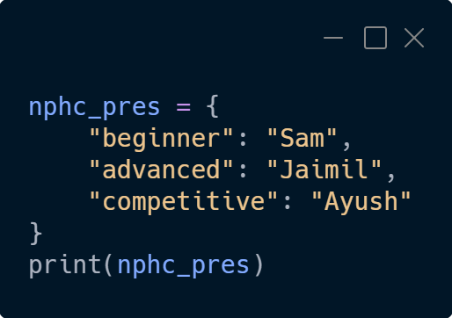
DICTIONARIES
Dictionaries are used to store data in key : value pairs
They can be used to store multiple pairs in one single variable
They are created using curly brackets
Their items are ordered (since Python 3.7), changeable, and does not allow duplicates
Their items are presented in key : value pairs
Their items can be referred to by using the key name.

Slide 5
two
DICTIONARY MANIPULATION

Slide 6
CHANGING VALUES
dict[“key”] = new value
dict.update({“key”: value})
Update the dictionary items from the given statement.
Change the value of a specific item by referring to its key name
Mars is a cold place

Slide 7
ADDING VALUES
dict[“new key”] = new value
dict.update({“new key”: new value})
Update the dictionary items from the given statement.
Add an item to the dictionary by using a new index key and assigning a value to it
Mars is a cold place

Slide 8
REMOVING VALUES
del dict[“key”]
Removes the last inserted item
Deletes the item with the specified key name
Can also completely delete the dictionary
dict.pop(“key”)
del dict
Removes the item with the specified key name
dict.popitem()

Slide 9
A FEW OTHER METHODS
dict.clear()
dict.copy()
dict.values()
Removes all elements from the dictionary
Returns a copy of the dictionary
Return a list of all values in the dictionary

Slide 10
three
TASK FOR THE WEEK

Slide 11
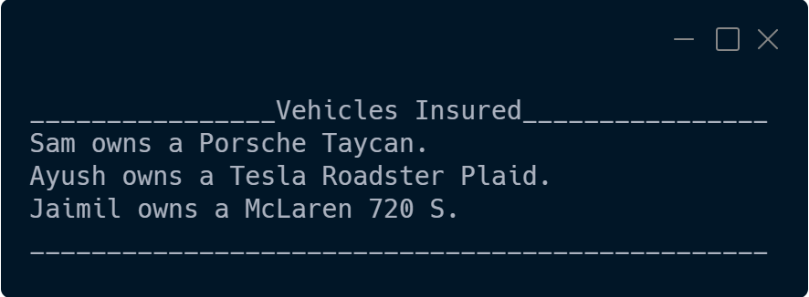
INSURED CARS
An insurance agency is feeling lazy so they’ve hired you to create a program to do a simple task for them.
They have requested you to do a simple demo, they have 3 cars that they have insured, they want to be able to enter the data and it generate a message about the cars they insure.
The message says “ownername owns a brandname model.” for all 3 cars.
Use lists to create a program that collects input for all 3 cars, then prints out data formatted like so:

Slide 12

GOOD LUCK
Good Luck on the task, reach out on discord by making a ticket

